Slide 1
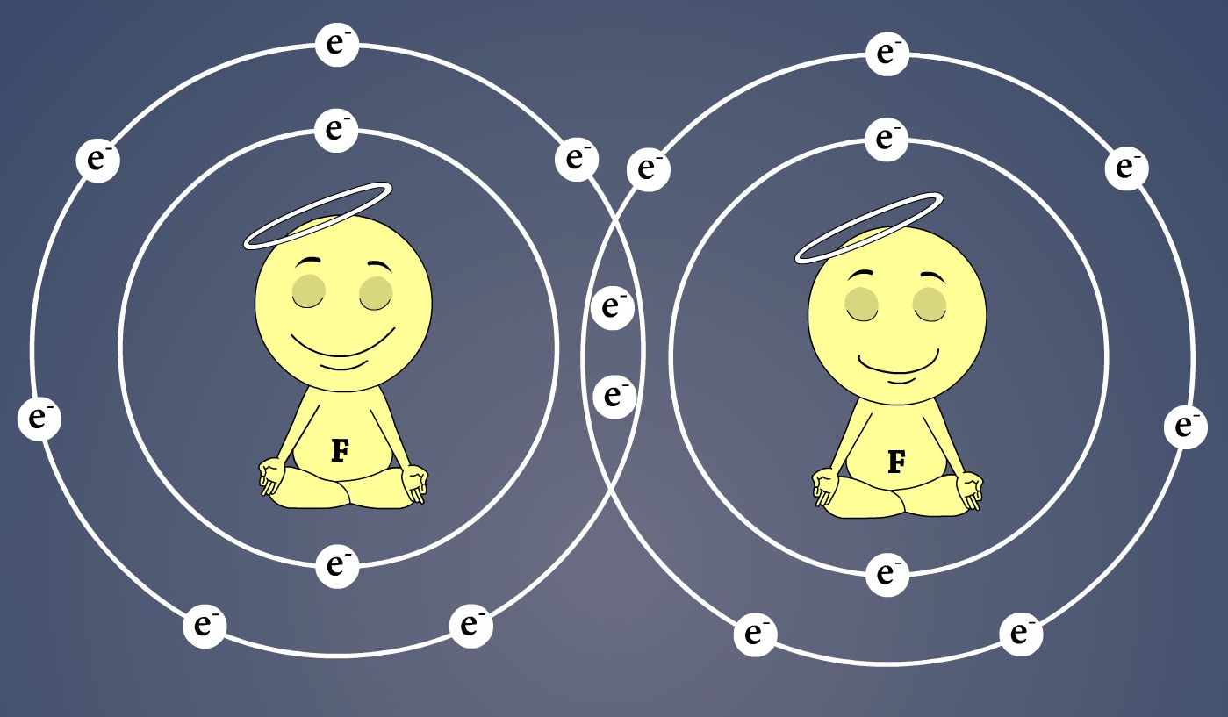
Chemical Bonding: Diatomic Molecules

Slide 2
Bonding: H₂⁺ and H₂ molecules
-
e⁻
r_{A}
r_{B}
r
+
+
R
H_{A}
H_{B}
-
e⁻
r_{1A}
r_{1B}
r₁
H_{A}
+
+
H_{B}
r₂
R
r_{2A}
r_{2B}
e⁻
-

Slide 3
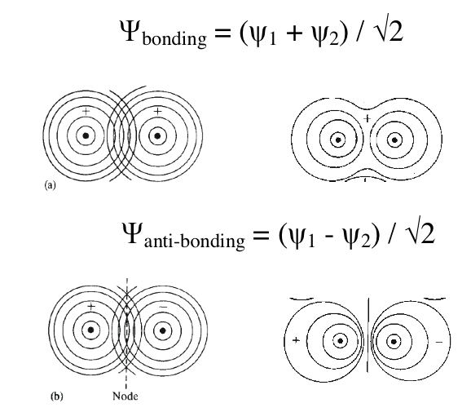
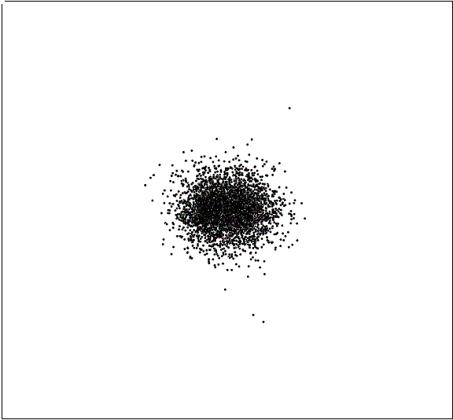
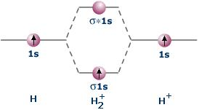
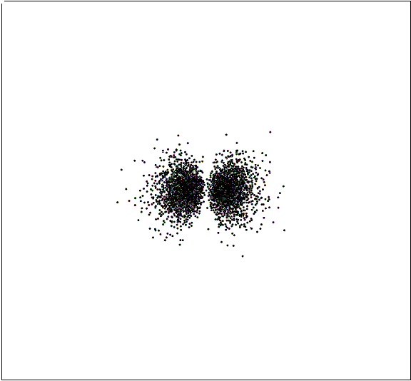
Molecular Orbital Theory of H₂⁺

Slide 4
Molecular Orbital Theory of H₂⁺
for combinations of 1s orbitals
McQuarrie and Simon Chapter 9,
Equations 9.11, 9,23, 9,24

Slide 5
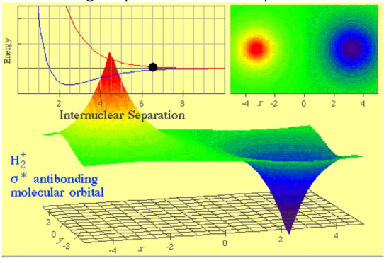
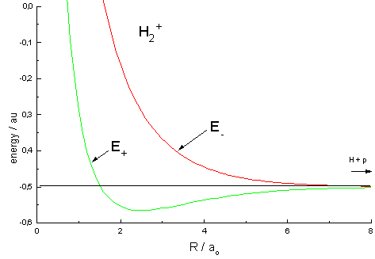
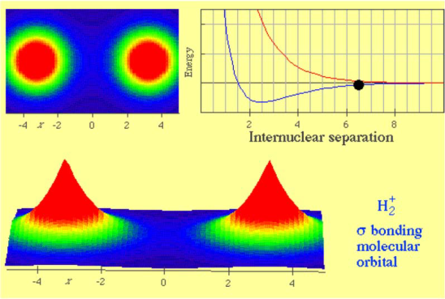
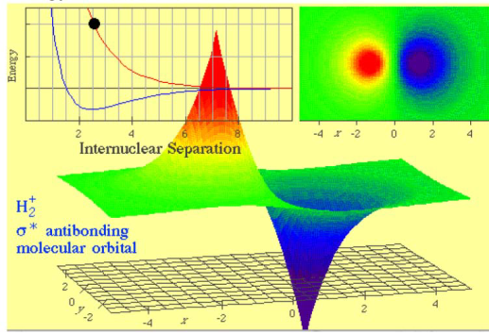
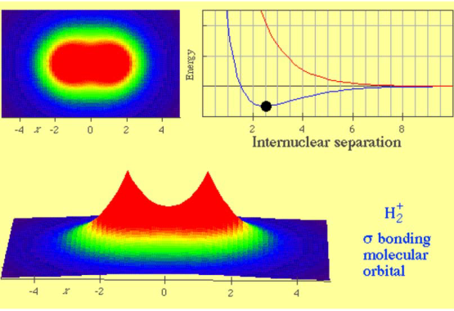
Molecular Orbital Theory of H₂⁺
E₂
1
E₁

Slide 6
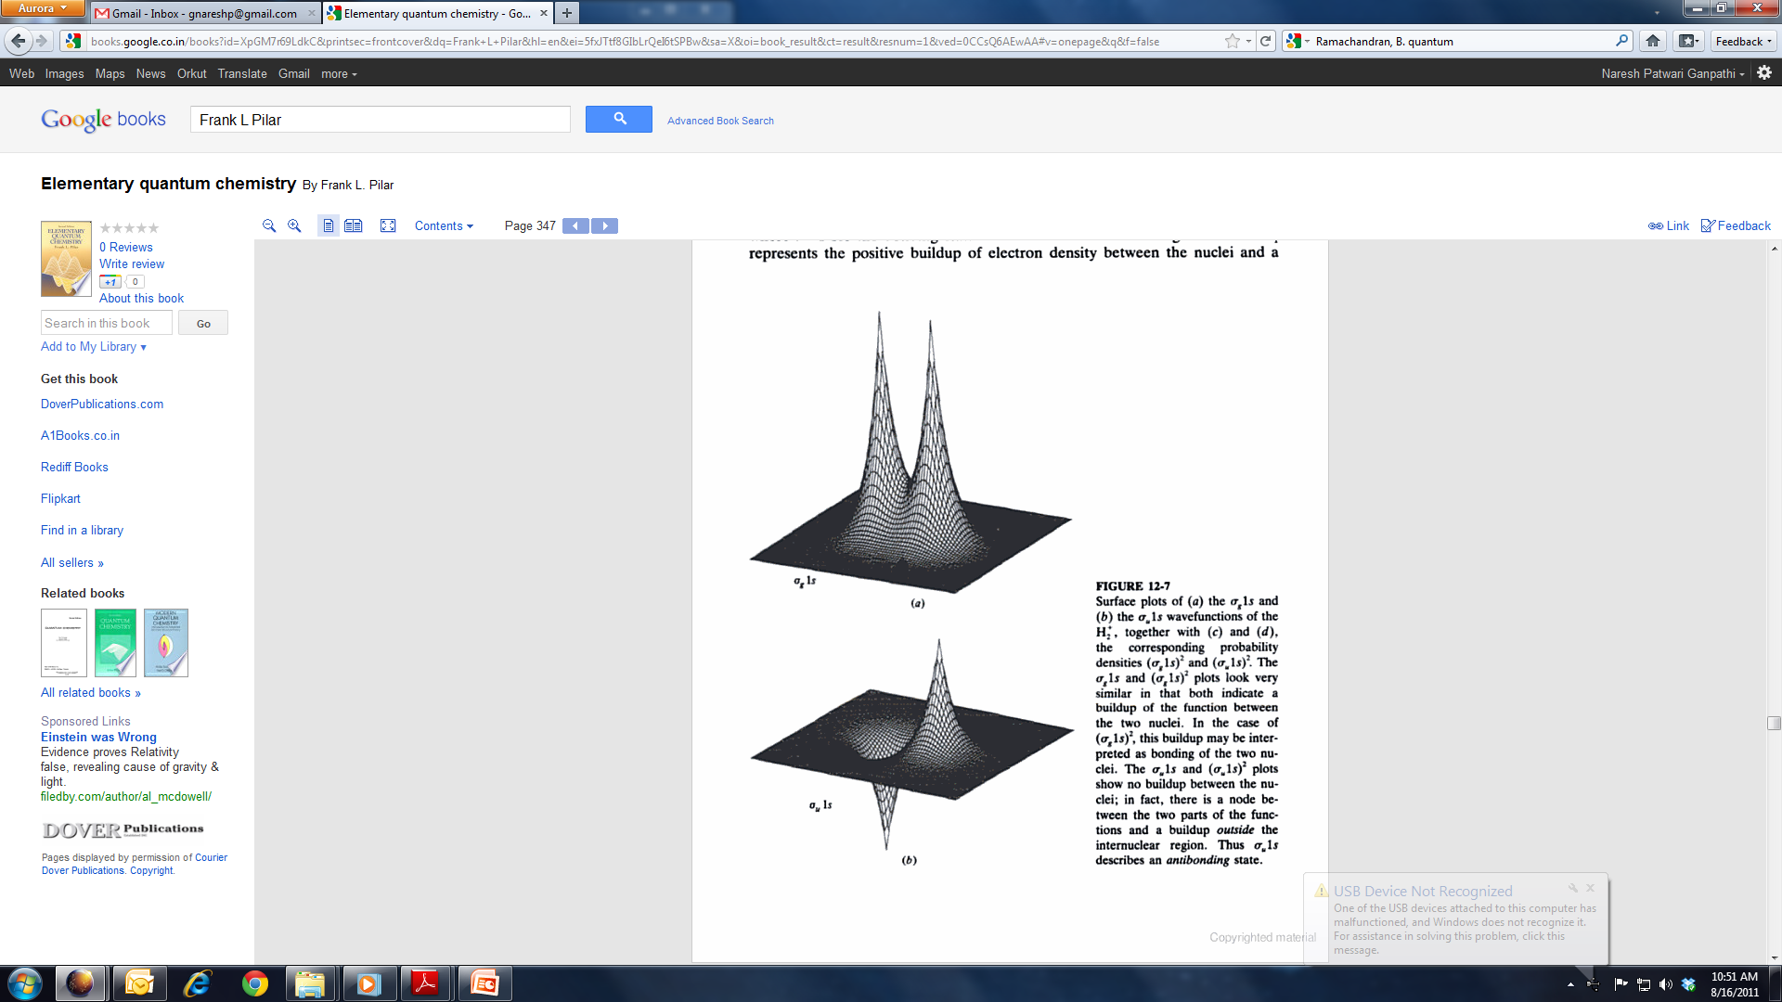
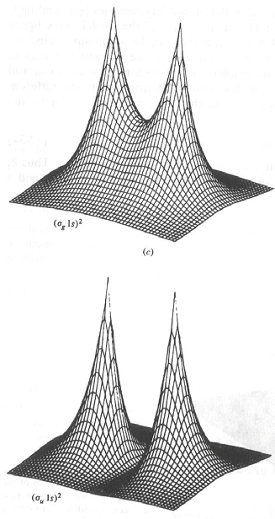
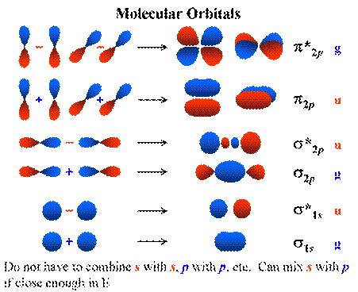
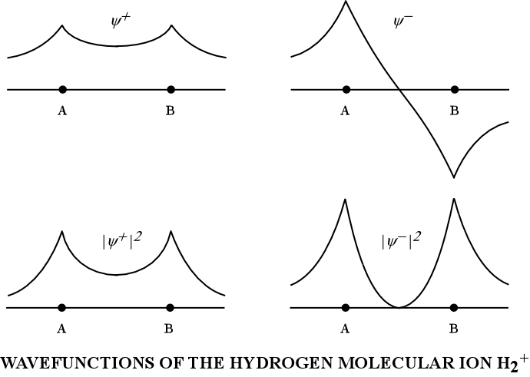
Sigma Bonding with 1s Orbitals

Slide 7
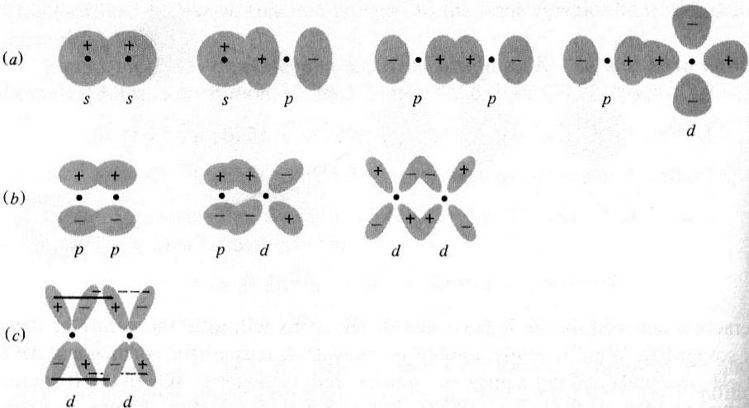
Types of Bonds

Slide 8
-
e⁻
Bonding: H₂ molecule
r_{1A}
r_{1B}
Born – Oppenheimer Approximation
r₁
H_{A}
+
+
H_{B}
r₂
R
r_{2A}
r_{2B}
e⁻
-
NOT a constant
CANNOT be Solved
For all the molecules except the simplest molecule H₂⁺ the Schrodinger equation cannot be solved.
We need methods to find approximate solutions

Slide 9
Molecular Orbital Theory of H₂
For H₂⁺
Place the second electron in the bonding orbital to get H₂ (ground state)

Slide 10
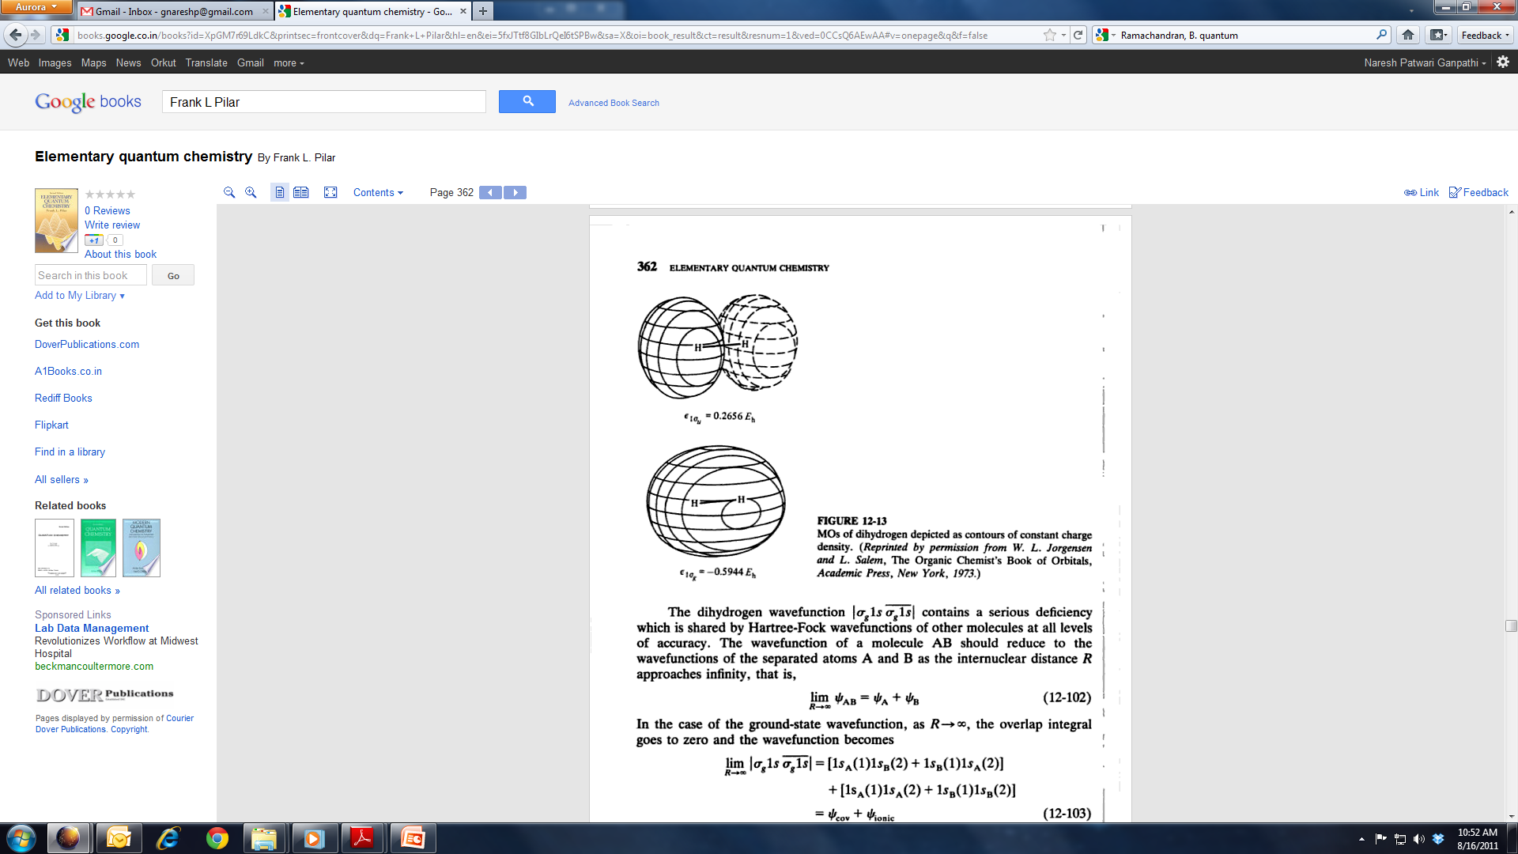
Molecular Orbital Theory of H₂
Spatial Part
Ionic terms: overemphasized

Slide 11
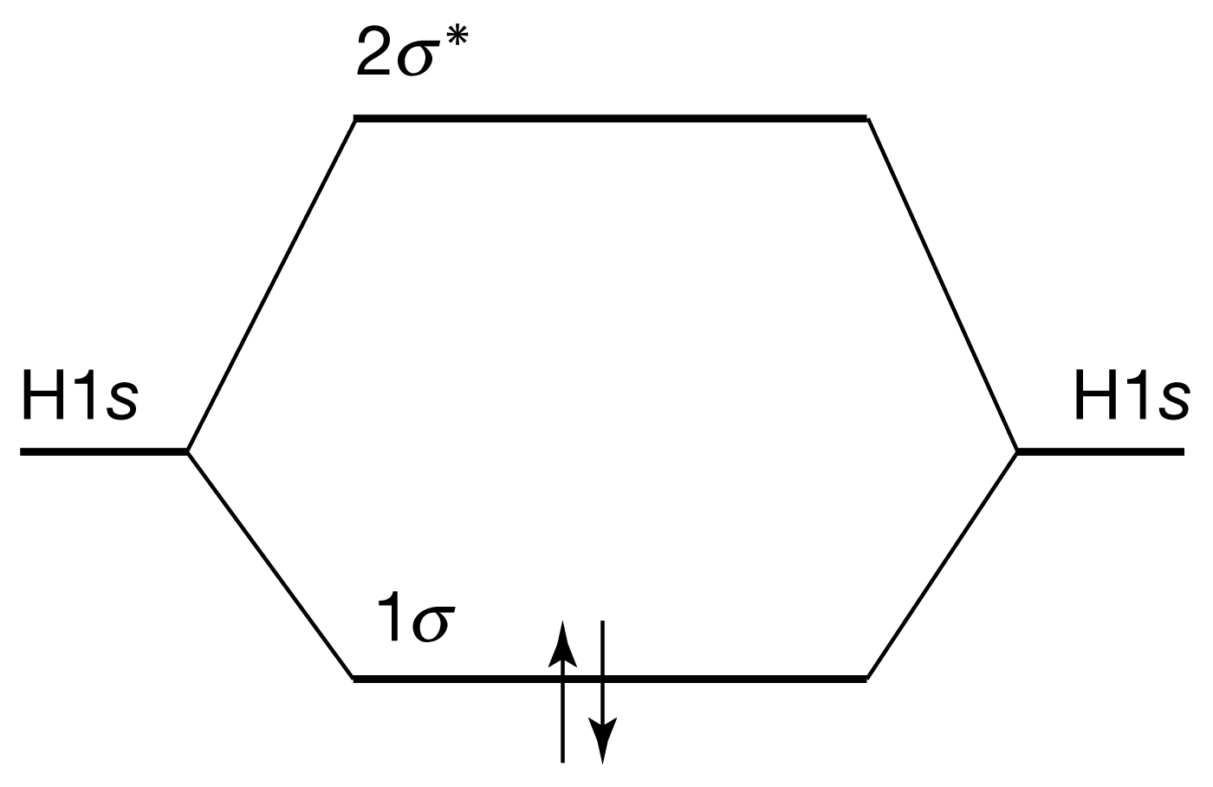
Molecular Orbital Theory of H₂

Slide 12
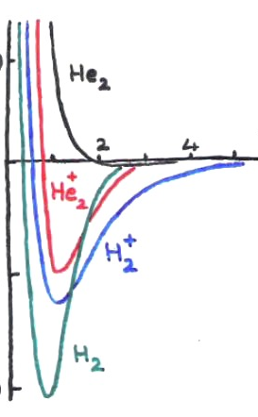
Diatoms of First Row: H₂⁺, H₂ ,He₂, He₂⁺
He₂
He₂⁺
H₂⁺
H₂
Species | No. of electrons | Electron confign. | Bond order | Bond length (pm) | Binding energy (kJ mol⁻¹)
H₂⁺ | 1 | (1σ)¹ | 0.5 | 106 | 268
H₂ | 2 | (1σ)² | 1 | 74 | 457
He₂⁺ | 3 | (1σ)²(1σ∗)¹ | 0.5 | 108 | 241
He₂ | 4 | (1σ)²(1σ∗)² | 0 | 6000 | <<1

Slide 13
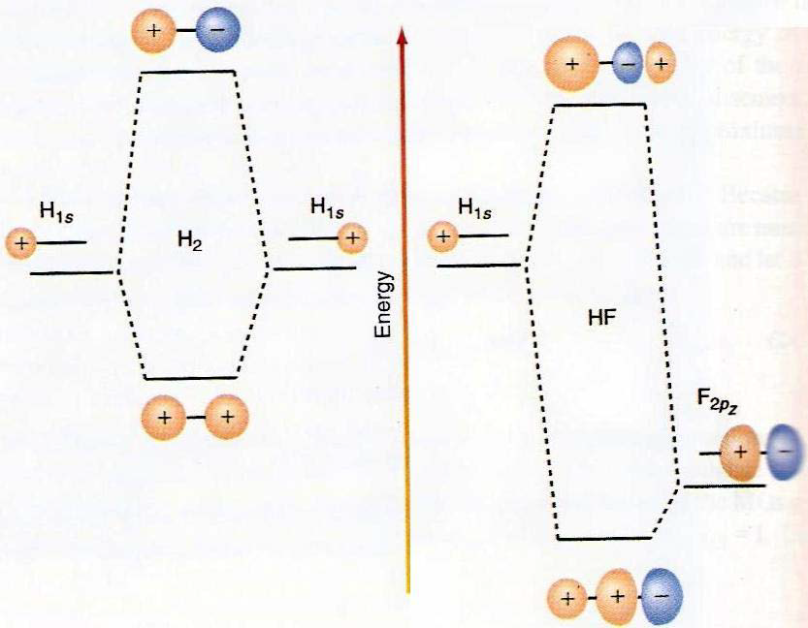
Matching of AO energies for MO
Both symmetry and energy
Matching is required for MO.
Valence electrons are most important
Due to large difference in energy of 1s(H) and 1s(F), LCAO-MO for both 1s is not feasible in HF.
Rather, 2p_{z}(F) and 1s(H) form a sigma bond.

Slide 14
Bonding in 2nd Row Homo-Diatomic Molecules
2p
2p
2s
2s
1s
1s
The orbital energies of the two approaching atoms are identical before they start interacting to form a BOND

Slide 15
Bonding in First-Row Homo-Diatomic Molecules
3σ*
2p
1π*
2p
1π
3σ
2σ*
2s
2s
2σ
1σ*
1s
1s
1σ
The interaction between the energy and symmetry matched orbitals leads to various types of BONDs

Slide 16
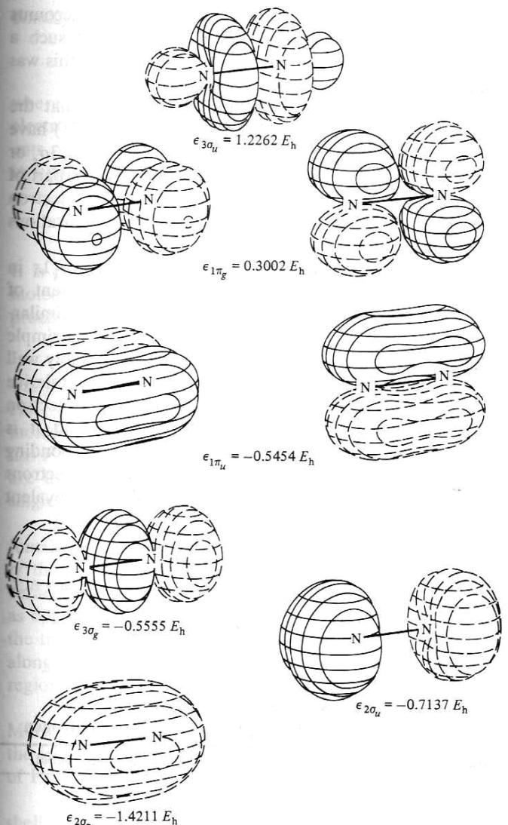
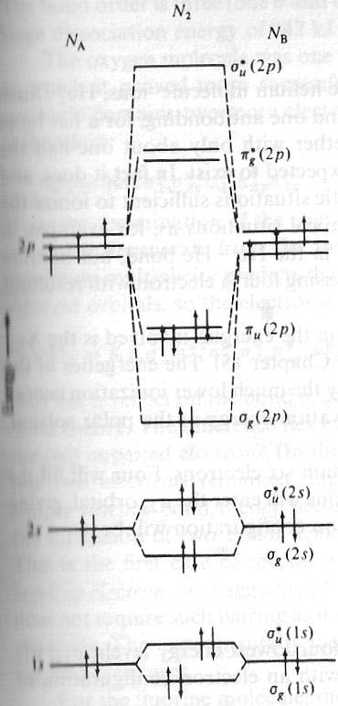
MO Energies of Dinitrogen
Experiments tell us this picture is incorrect!

Slide 17
Bonding in 2nd Row Homo-Diatomic Molecules
2p
2p
2s
2s
1s
1s
The 2s and 2p orbitals are degenerate in Hydrogen. However in the many electron atoms these two sets of orbitals are no longer degenerate.

Slide 18
Bonding in 2nd Row Homo-Diatomic Molecules
2p
2p
2s
2s
1s
1s
The difference in the energies of the 2s and 2p orbitals increases along the period. Its is minimum for Li and maximum for Ne

Slide 19
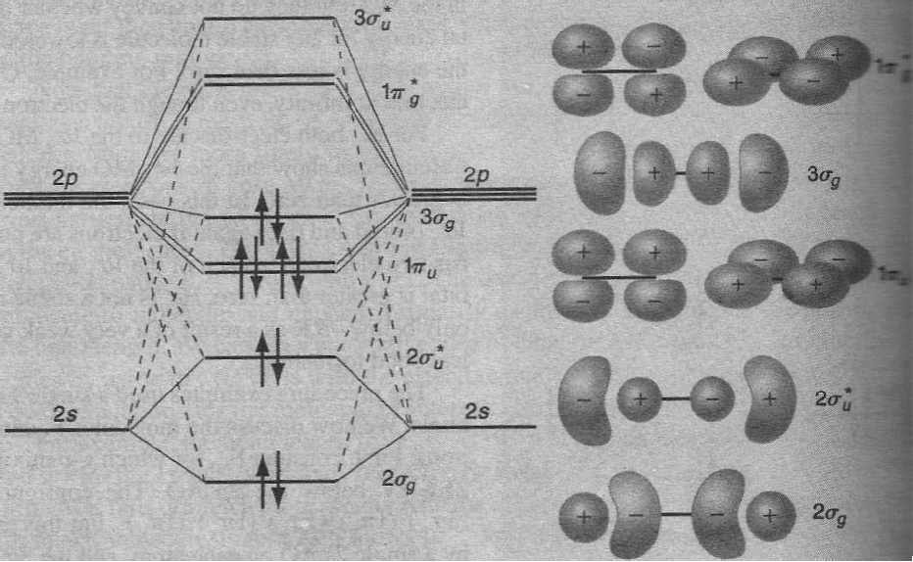
MO Energies of Dinitrogen
Mixing of 2s and 2p orbital occur because of small energy gap between them
2s and 2p electrons feels not so different nuclear charge.
Note how the MO of 2s→σ have p-type looks, while π-levels are clean

Slide 20
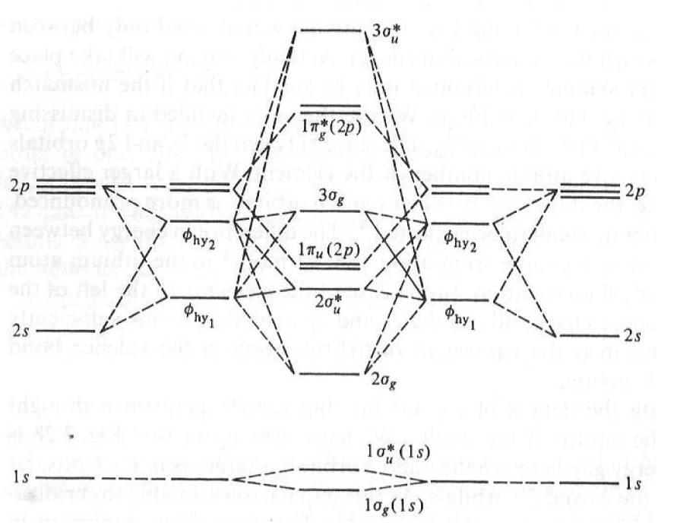
s-p Mixing: Hybridization of MO
Mixing of 2s and 2p orbital occur because of small energy gap between them 2s and 2p electrons feels not so different nuclear charge

Slide 21
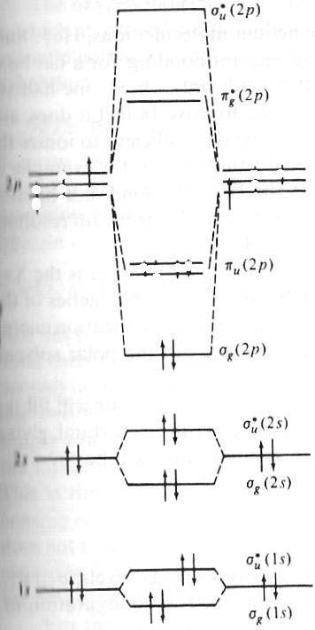
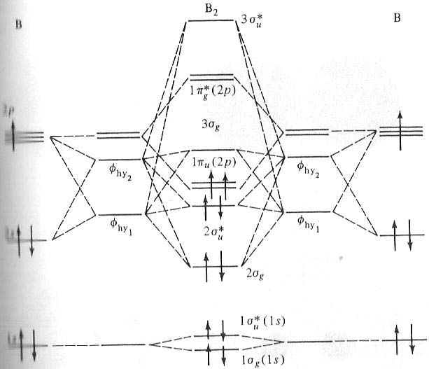
s-p Mixing: Hybridization of MO
Incorrect!
B₂ is paramagnetic. This can only happen if the two electrons with parallel spin are placed in the degenerate π-orbitals and if π orbitals are energetically lower than the σ orbital

Slide 22
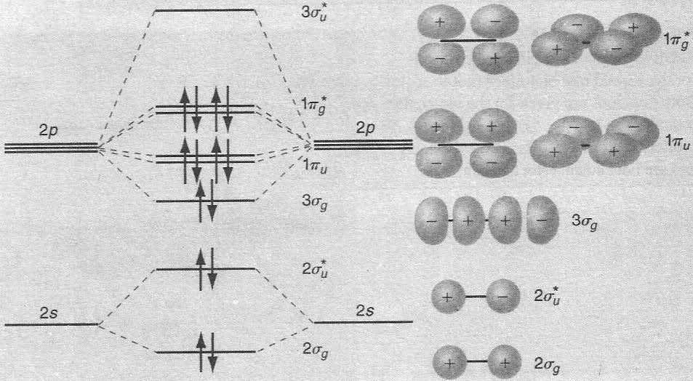
MO diagram of F₂: No s-p Mixing
No Mixing of s and p orbital because of higher energy
Gap between 2s and 2p levels in Oxygen and Fluorine!
2s and 2p electrons feels very different nuclear charge

Slide 23
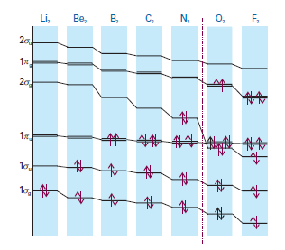
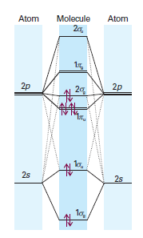
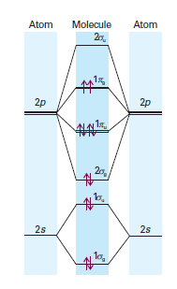
MO Energy Level Diagram for Homo-Diatomics
Upto N₂
Beyond N₂

Slide 24
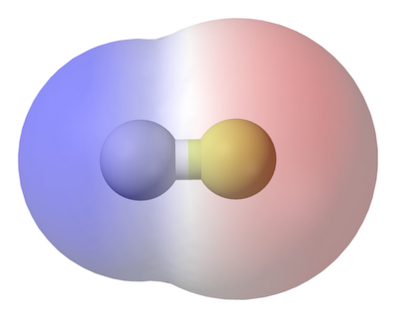
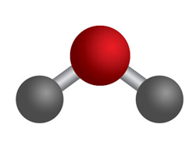
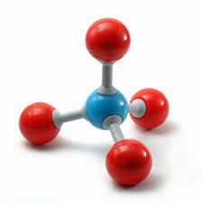
Heteronuclear Diatomic and Polyatomic Molecules

Slide 25
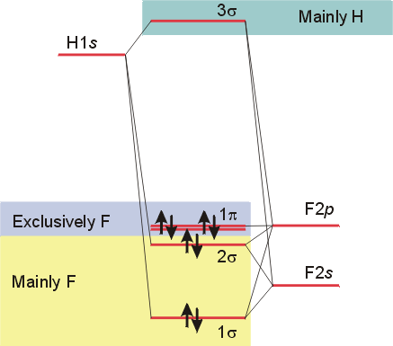
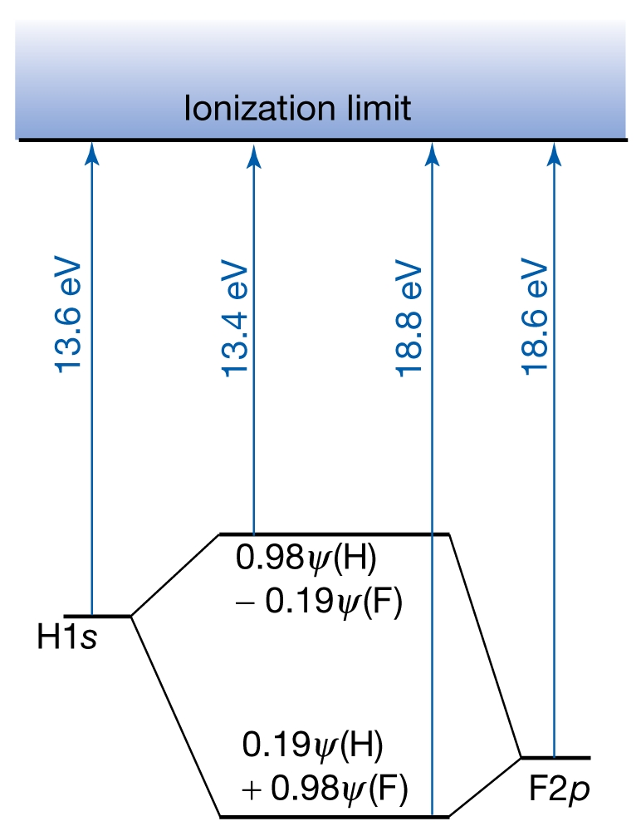
Heteronuclear Diatomics: HF
Higher electronegativity of F: Lopsided electron distribution
Bonding and antibonding MOs: s as well as p
Unequal contribution from the two atoms

Slide 26
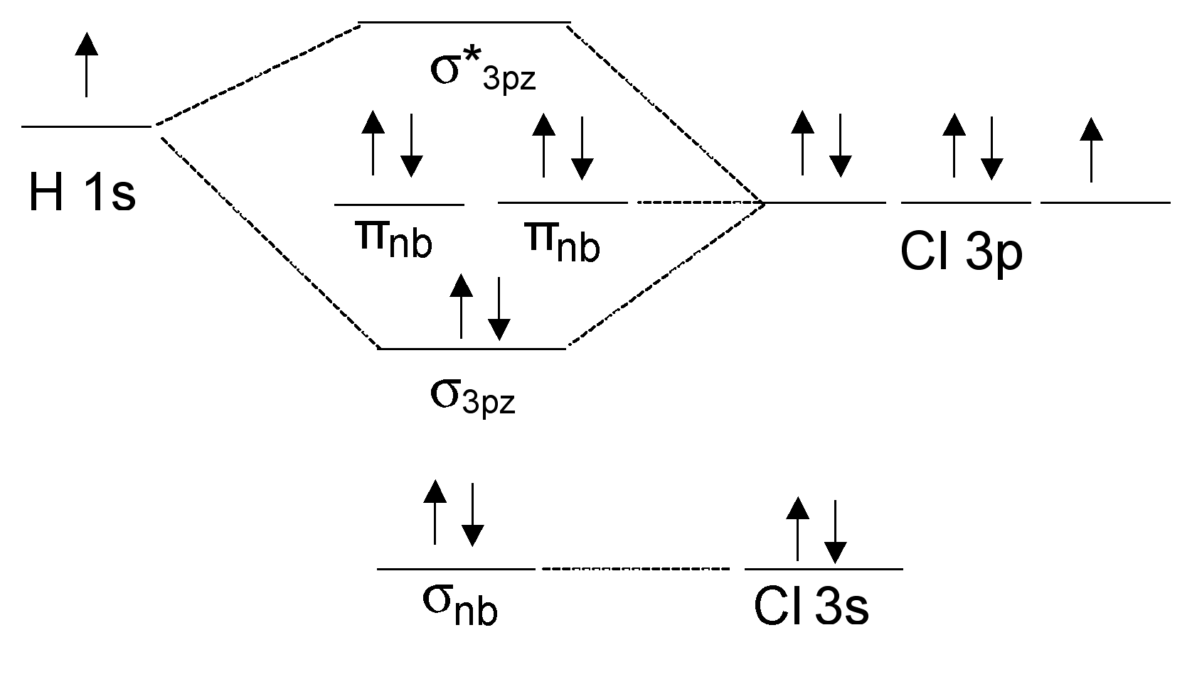
Heteronuclear Diatomics: HCl
For Cl 3p states close in energy to the 1s of H

Slide 27
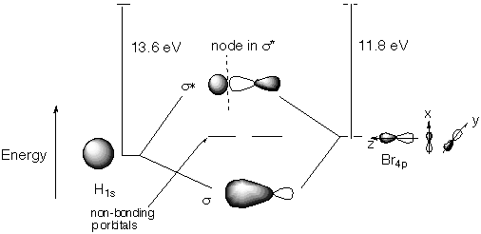
Heteronuclear Diatomics: HBr
For Br 4p states close (higher) in energy to the 1s of H

Slide 28
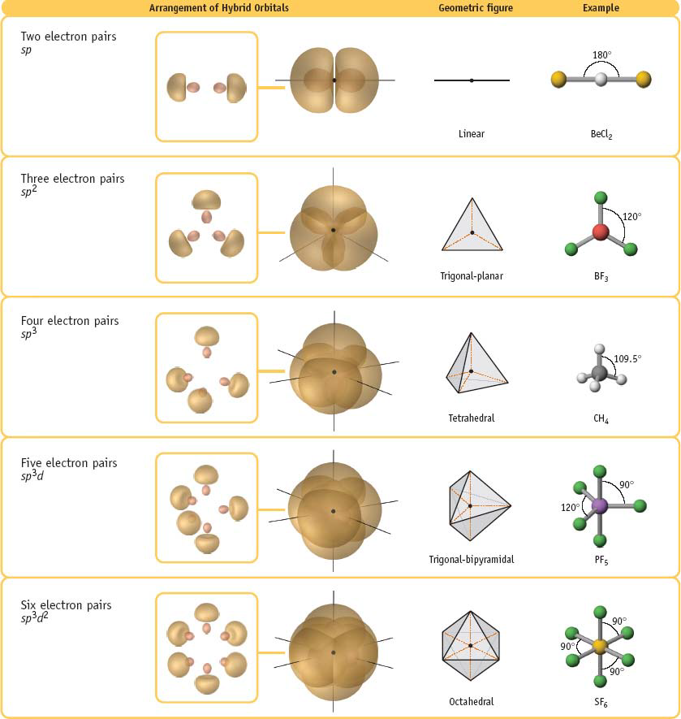
Polyatomic molecules: Geometry

Slide 29
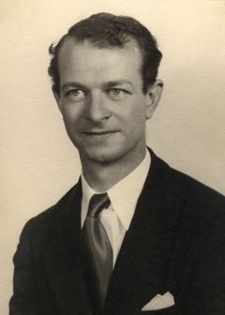
Linear combination of atomic orbitals within an atom leading to more effective bonding
Hybridization
2p_{z}
2p_{x}
2p_{y}
2p_{x}
2p_{y}
γ 2s+δ 2p_{z}
α 2s+β 2p_{z}
2s
The coefficients α, β, γ and δ depend on field strength
Square of a coefficient = contribution of that AO in the hybrid orbital
Equivalent hybrid orbitals (same s-contribution, same p-contribution in each hybrid orbital) have same energies
Hybrid orbitals are ortho-normal to each other
Hybridization origintes in VBT and relies on experimental results

Slide 30
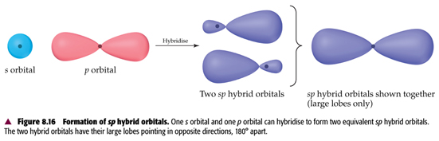
s+p (sp) hybridization
s and p orbital of the SAME atom!
No question of S (overlap integral)
2 equivalent hybrid orbitals of the same energy and shape (directions different)
Linear geometry with
Hybridized atom at the center
Contribution from s = 0.5; contribution from p = 0.5

Slide 31
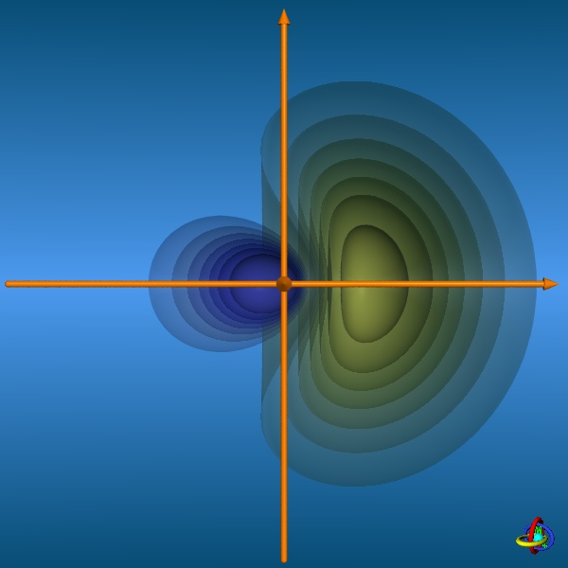
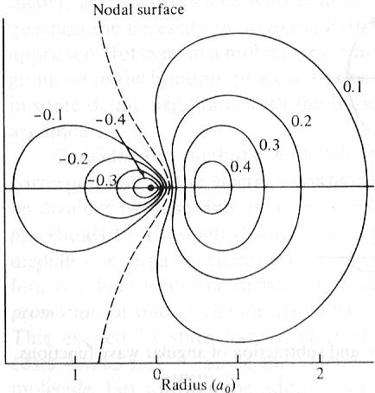
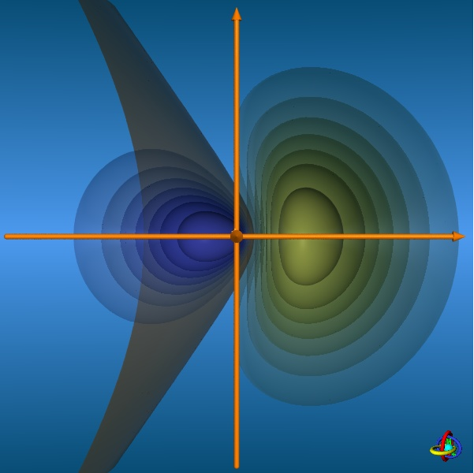
Contours of a sp hybrid orbital
http://csi.chemie.tu-darmstadt.de/ak/immel/script/redirect.cgi?filename=http://csi.chemie.tu-darmstadt.de/ak/immel/tutorials/orbitals/

Slide 32
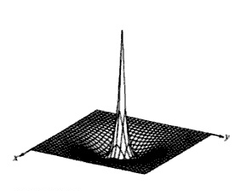
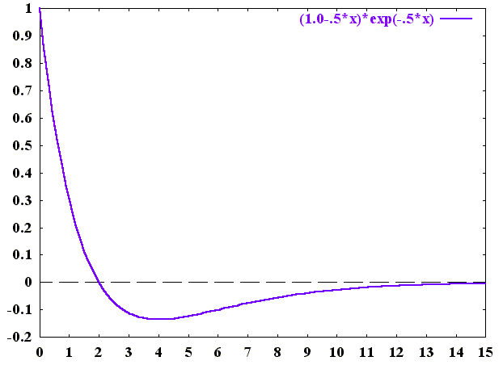
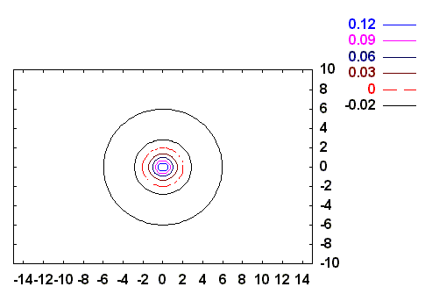
2s orbital
radial node
Y. U. Sasidhar

Slide 33
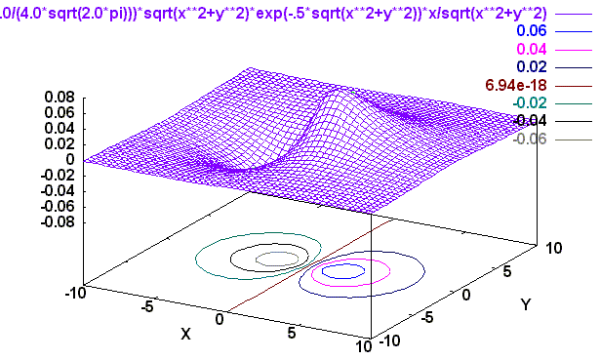
2p_{z} orbital
Angular Part
(2,1,0)
X
Z

Slide 34
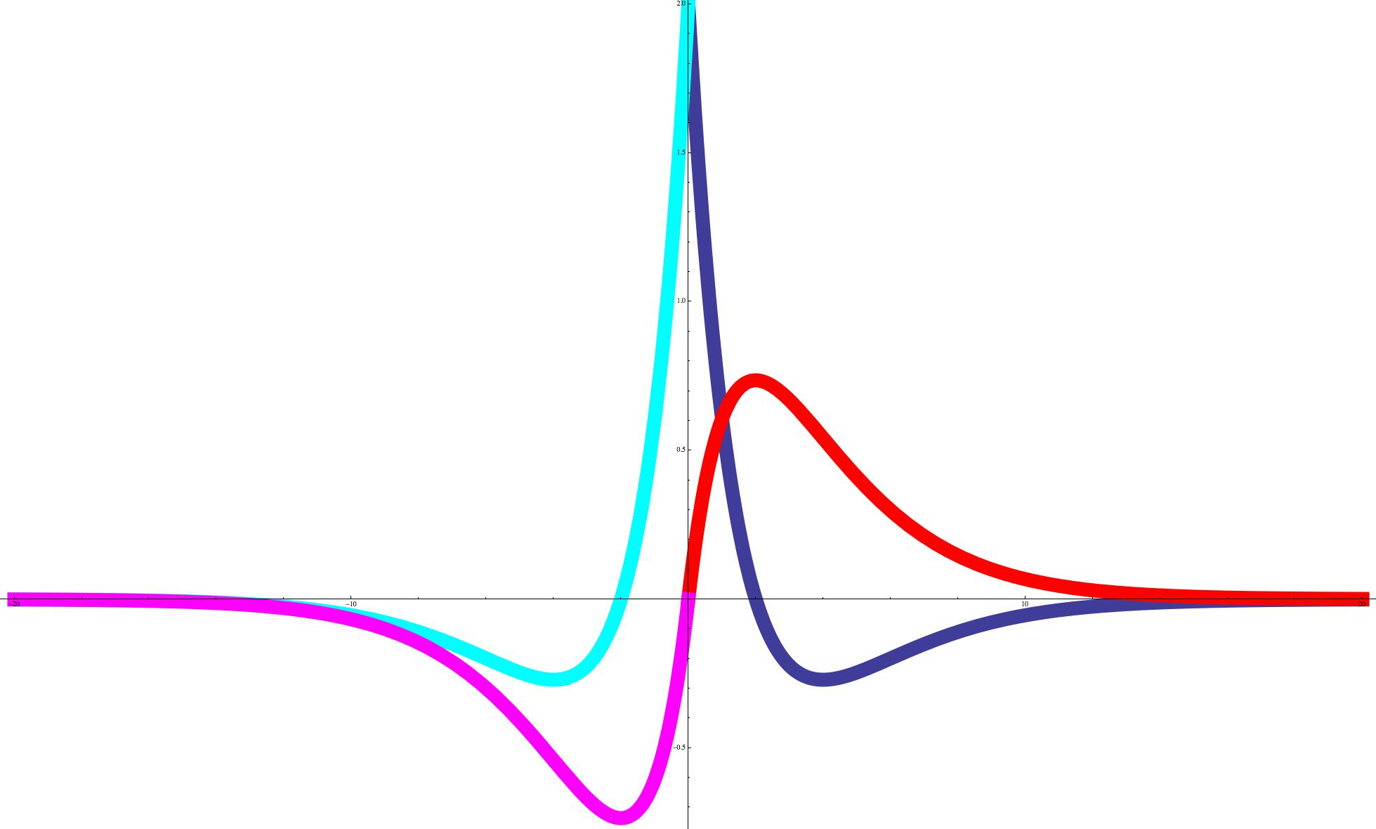
Sections of the orbitals
2s
2s
2p_{z}
2s
2p_{z}
2s

Slide 35
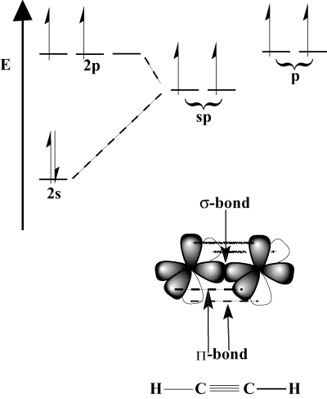
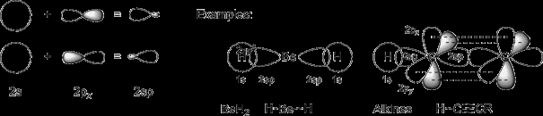
Bonding using sp hybrid orbitals
The other p orbitals are available for π bonding

Slide 36
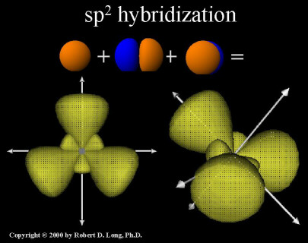
Trigonal geometry: Mixing s & two p orbitals
p_{x} and p_{y} can be combined with s to get three 3 equivalent hybrids at 120º to each other
+y
hy1
Θ₃
Θ₁
-x
+x
hy3
Θ₂
-y
hy2

Slide 37
Coefficients of AOs for specifically oriented sp² hybrid orbitals
30º
+y
+y
h1
+y
+x
+x
30º
30º
30º
+x
h2
h3

Slide 38
Coefficients from the conditions of Orthonormality
30º
h1
+y
30º
h3
+x
h2

Slide 39
Coefficients from the conditions of Orthonormality
30º
h1
+y
30º
h3
+x
h2

Slide 40

Signs and coefficients for these particular sp² hybrids
30º
h1
+y
30º
h3
+x
h2
Square of coefficients ➔ Contribution from s=0.33; from p=0.66

Slide 41


Hybridization of s & three p orbitals (sp³):
Tetrahedral geometry
Contributions from s = 25%; p=75%
There is no unique combination/solution
(depends on the orientation!)

Slide 42
Angles between two hybrid orbitals

Slide 43


What if h1 is oriented along z-axis?
Tutorial problem

Slide 44
What if h1 is oriented along z-axis?
Tutorial problem

Slide 45
What if h1 is oriented along z-axis?
Tutorial problem

Slide 46
What if h1 is oriented along z-axis?
Tutorial problem

Slide 47

What if h1 is oriented along z-axis?
Tutorial problem

Slide 48

What if h1 is oriented along z-axis?
Tutorial problem

Slide 49
Bond angles
Tutorial problem
angle between two vectors

Slide 50
Bond angles
Tutorial problem

Slide 51
Bond angles
Tutorial problem

Slide 52
Non-equivalent Hybrid Orbitals: H₂O
H_{b}
+z
H_{a}
H—O—H angle (2θ = 104.5º)
θ
θ
2 H atoms along +z, in yz plane
2 Lone pair of electrons in xz plane (-z)
+y
Why take a negative sign of coefficient for 2s?
In order to get a “+” sign on the
major lobe of each hybrid orbital,
which have to form MO with 1s
orbital of H (with + sign)

Slide 53
Coefficients of 2 Hybrid Orbitals involved in bonding with H(1s)
Orthogonality:
H_{b}
+z
H_{a}
θ
θ
+y

Slide 54
Coefficients of 2 Hybrid Orbitals involved in bonding with H(1s)
Orthogonality:
H_{b}
+z
H_{a}
θ
θ
+y

Slide 55
Normalize each bonding hybrid orbital to obtain correct coefficients
% p character: (0.55)²+(0.71)²=0.80 (80%)
% s character = (-0.45)² = 0.2 (20%)
➔ more like sp⁴ , rather than sp³

Slide 56
Lone-pair hybrid orbitals have different coefficients!
H_{a}
+z
d₂=d₆=0
+x
H_{b}
LP₁
Θ
Θ
H_{b} behind H_{a}
+y
+z
Φ
-z
H_{a}
H_{b}
2 Lone pair hybrids along negative z axis and in xz plane – No contribution from p_{y}
2p_{y}→0
LP₂
-x
LPs

Slide 57
Lone-pair hybrid orbitals have different coefficients!
d₂=d₆=0
+x
LP₁
H_{b} behind H_{a}
+z
Φ
-z
H_{a}
H_{b}
LP₂
-x

Slide 58
Lone-pair hybrid orbitals have different coefficients!
s : Same for both LP hybrid orbitals: d₃ = d₇
2p_{z} : Same for both LP hybrids: d₅ = d₁
2p_{x}: Same magnitude, opposite in sign: d₈ = -d₄
d₂=d₆=0
+x
LP₁
H_{b} behind H_{a}
+z
Φ
-z
H_{a}
H_{b}
LP₂
-x

Slide 59
Total contribution of s, p_{x}, p_{y}, p_{z} is unity considering all four hybrids
For lone-pair
hybrid orbitals:
For bonded
hybrid orbitals:
For 2p_{z}
For 2p_{y}
For 2s
For 2p_{x}

Slide 60
Different s-/p- character for the two classes of hybrids in H₂O
H_{b}
+z
H_{a}
+x
LP₁
Θ
Θ
+z
Φ
-z
+y
H_{a}
H_{b}
LP₁
LP₂
LP₂
-x
s➔(0.55)²→30%
p➔100-30→70%
s➔ 20%
p➔ 80%

Slide 61



Hybridization of s,p,d: sp³d² and sp³d
sp³d²: octahedral
Similarly, sp³d →
trigonal bipyramidal

Slide 62
Hybridization vs. MOT
Hybridization: Highly directional, localized bonds
MOT: Delocalized MOs
Do they agree?
Does MOT provide some extra information?

Slide 63
Methane: VBT picture with sp₃ orbitals
Contributions from s = 25%; p=75%
There is no unique combination/solution
(depends on the orientation!)

Slide 64
Methane: Delocalized MOT picture
AOs with proper symmetry can only be combined
Central Carbon atom: 2s and 2p orbitals

Slide 65
Methane: Delocalized MOT picture
2s orbital
P
Q
Linear combination of hydrogen
1s orbitals with matching symmetry:
S
R

Slide 66
Methane: Delocalized MOT picture
2p orbital
P
Q
Linear combination of hydrogen
1s orbitals with matching symmetry:
3 such linear combinations:
x, y, z
S
R

Slide 67
Methane: Delocalized MOT picture
Two kinds of Molecular Orbitals
1 MO, no node
3 MOs, one node in each
Same energy?
Experimental evidence?

Slide 68

Methane: Energy Diagram and Photoelectron spectrum
C H
2p
4 × 1s
2s
2 kinds of MOs: 2 energy levels
Bond lengths: equal
All MOs contribute equally to each bond
VB and MO pictures correlated
Properties depend on the experiment
http://bilbo.chm.uri.edu/CHM401/fall2008exam1-4.html

